Slide 1
Software Evolution and Maintenance
Chapter 1
Software Evolution and Maintenance Concepts
Evolution versus maintenance
Software Evolution
Types of Software Maintenance
Evolution & Maintenance Models
Configuration Management
Reengineering
Legacy Systems
Refactoring
Software Reuse
Another ﬂaw in the human character is that everybody wants to build and nobody wants to do maintenance. —Kurt Vonnegut, Jr

Slide 2
Software Evolution and Maintenance Concepts
The concept of software maintenance means preventing software from failing to deliver the intended functionalities by means of bug fixing.
The concept of software evolution means a continual change from a lesser, simpler, or worse state to a higher or better state.
Bennett and Xu made further distinctions between the two as follows:
All support activities carried out after delivery of software are put under the category of maintenance.
All activities carried out to effect changes in requirements are put under the category of evolution.

Slide 3
Software Evolution and Maintenance Concepts
Software maintenance comprises all activities associated with the process of changing software for the purposes of:
fixing bugs; and/or
improving the design of the system
future changes to the system are less expensive.
Evolution of software systems means creating new but related designs from existing ones. The objectives include:
supporting new functionalities
making the system perform better
making the system run on a different OS

Slide 4
Software Evolution: SPE Taxonomy
The abbreviation SPE refers to S (Specified), P (Problem), and E (Evolving) programs.
S-type programs: S-type programs have the following characteristics:
All the nonfunctional and functional program properties that are important to its stakeholders are formally and completely defined.
Correctness of the program with respect to its formal specification is the only criterion of the acceptability of the solution to its stakeholders.
P-type programs: With many real problems, the system outputs are accurate to a constrained level of precision. The concept of correctness is difficult to define in those programs.

Slide 5
Software Evolution: SPE Taxonomy
E-type programs: An E-type program is one that is embedded in the real world and it changes as the world does.
These programs mechanize a human or society activity, make simplifying assumptions, and interface with the external world by requiring or providing services.
An E-type system is to be regularly adapted to:
(i) stay true to its domain of application
(ii) remain compatible with its executing environment
(iii) meet the goals and expectations of its stakeholders

Slide 6
Software Evolution
Fundamental work in the field of software evolution was done by Lehman and his collaborators.
Based on empirical studies, Lehman and his collaborators formulated some observations and they introduced them as laws of evolution.
The “laws” themselves have “evolved” from three in 1974 to eight by 1997.
Those laws are the results of studies of the evolution of large-scale proprietary or closed source software (CSS) systems.
Lehman and his colleagues have postulated eight “laws” over 20 years starting from the mid-1970s to explain some key observations about the evolution of E-type software systems

Slide 7
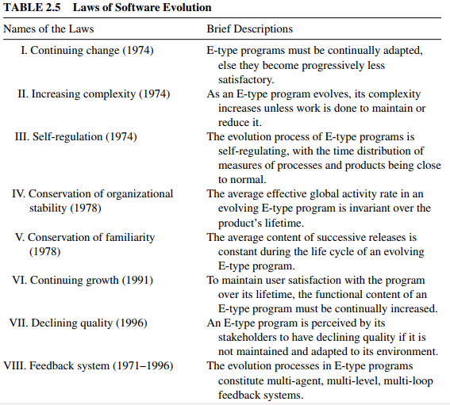
Software Evolution

Slide 8
Software Maintenance-Development
Software Maintenance Vs. Development
Development | Maintenance
development is requirements driven | maintenance is event driven
Begins with designing and implementing a system to deliver functional and nonfunctional requirements. | A maintenance task is scheduled in response to an event.
 | Events : change request needs to fix a set of bugs

Slide 9
Types of Software Maintenance
There are defects in delivered software applications, because defect removal and quality control processes are not perfect.
Therefore, maintenance is needed to repair those defects in released software.
E. Burton Swanson initially defined three categories of software maintenance activities, namely, corrective, adaptive, and perfective.
Those definitions were later incorporated into the standard software engineering–software life cycle processes–Maintenance and introduced a fourth category called preventive maintenance.
The reader may note that some researchers and developers view preventive maintenance as a subset of perfective maintenance.

Slide 10
Types of Software Maintenance
In the following subsections, we explain maintenance activities from three viewpoints:
Intention-based classification of software maintenance activities;
Activity-based classification of software maintenance activities
Evidence-based classification of software maintenance activities.

Slide 11
Types of Maintenance …
Intention-based classification of software maintenance activities
In this classification, one categorizes maintenance activities into four groups based on what we intend to achieve with those activities.
Based on the Standard for Software Engineering–Software Maintenance, ISO/IEC 14764 [3], the four categories of maintenance activities are corrective, adaptive, perfective, and preventive.
Corrective maintenance: the purpose of corrective maintenance is to correct failures: processing failures and performance failures.
A program producing a wrong output is an example of processing failure.
A program not being able to meet real-time requirements is an example of performance failure. Example: correcting a program that aborts or produces incorrect results.
corrective maintenance is a reactive process, which means that corrective maintenance is performed after detecting defects with the system.

Slide 12
Types of Maintenance …
Intention-based …
Adaptive maintenance
The purpose of adaptive maintenance is to enable the system to adapt to changes in its data environment or processing environment.
modifies the software to properly interface with a changing or changed environment
Some generic examples are:
changing the system to support new hardware configuration;
converting the system from batch to online operation;
changing the system to be compatible with other applications.
an application software on a smartphone can be enhanced to support WiFi-based communication in addition to its present 3G cellular communication

Slide 13
Types of Maintenance …
Intention-based …
Perfective maintenance
The purpose of perfective maintenance is to make a variety of improvements, namely: user experience, processing efficiency, and maintainability.
For example:
the program outputs can be made more readable for better user experience
the program can be modified to make it faster, thereby increasing the processing efficiency
the program can be restructured to improve its readability, so increasing its maintainability.
In general, activities for perfective maintenance include:
restructuring of the code
creating and updating documentations
tuning the system to improve performance

Slide 14
Types of Maintenance …
Intention-based …
Preventive maintenance
The purpose of preventive maintenance is to prevent problems from occurring by modifying software products.
For example
good programming styles can reduce the impact of change, thereby reducing the number of failure.
Preventive maintenance is very often performed on safety critical and high available software systems
software rejuvenation is a preventive maintenance measure to prevent, or at least postpone, the occurrences of failures due to continuously running the software system.
Software rejuvenation is a proactive fault management technique aimed at cleaning up the system internal state to prevent the occurrence of more severe crash in the future

Slide 15
Types of Maintenance…
Activity-Based Classification of Software Maintenance
In Kitchenham et al. organize maintenance modification activities based on the maintenance activity.
Corrections
Activities are designed to fix defects in the system, where a defect is a discrepancy between the expected behavior and the actual behavior of the system.
Enhancements
Activities are designed to effect changes to the system. The changes to the system do not necessarily modify the behavior of the system.
enhancement activities that modify some of the existing requirements implemented
enhancement activities that add new system requirements
enhancement activities that modify the implementation without changing the requirements implemented by the system.

Slide 16
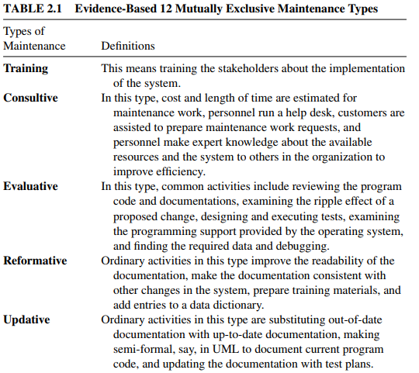
Types of Maintenance…
Evidence-Based Classification of Software Maintenance
The intention-based classification of maintenance activities was further refined by Chapin et al.

Slide 17

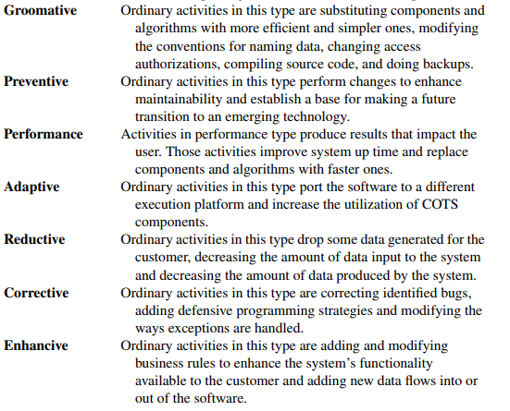
Types of Maintenance…
Evidence-Based…

Slide 18
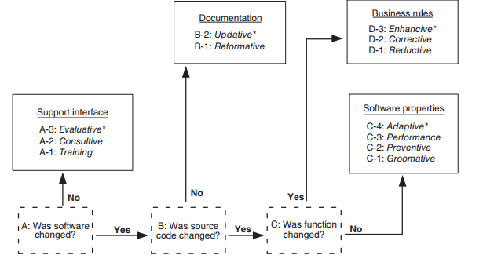
Types of Maintenance…
Evidence-Based…

Slide 19
Software Maintenance: COTS
New components are developed by combining commercial off-the-shelf (COTS) components, custom-built (in-house) components, and open source software components.
The major differences between component-based software systems (CBS) and custom-built software systems:
Skills of system maintenance teams: Maintenance of CBS requires specialized skills to monitor and integrate COTS products.
Infrastructure and organization: Running a support group for in-house products is necessary to manage a large product.
COTS maintenance cost: This cost includes the costs of purchasing components, licensing components, upgrading components, and training maintenance personnel.
Larger user community: COTS users are part of a broad community of users, and the community of users can be considered as a resource, which is a positive factor.

Slide 20
Software Maintenance : COTS…
Modernization: vendors of COTS components keep pace with changing technology and continually update the components. As a result, the system does not become obsolete.
Split maintenance function: A COTS product is maintained by its vendor, whereas the overall system that uses the COTS product is maintained by the system’s host organization. As a result, multiple, independent maintenance teams exist. The advantage of COTS-based development is that the system maintainers receive additional support from the COTS vendors.
More complex planning: If a system depends upon multiple technologies and COTS products, the unpredictability and risk of change become high, and planning becomes complicated because coordination among a large number of vendors is more difficult.

Slide 21
Evolution And Maintenance Models
Software maintenance should have its own software maintenance life cycle (SMLC) model.
A number of SMLC models with some variations are available in literature. Three common features of the SMLC models found in the literature are:
Understanding the code
Modifying the code
Revalidating the code
There are three main software maintenance and evolution models view
Reuse-oriented Model
Staged model of maintenance
Change mini-cycle models

Slide 22
Evolution And Maintenance Models
Reuse-oriented Model
A new version of the system can be created after the maintenance activities are implemented on some of the old system’s components.
Based on this concept, three process models for maintenance have been proposed by Basili:
Quick fix model. In this model, necessary changes are quickly made to the code and then to the accompanying documentation (Figure 3.2).
Iterative enhancement model. In this model, as illustrated in Figure 3.3, first changes are made to the highest level documents. Eventually, changes are propagated down to the code level.
Full reuse model. In this model, as illustrated in Figure 3.4, a new system is built from components of the old system and others available in the repository

Slide 23
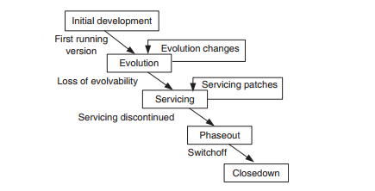
Evolution And Maintenance Models
The Staged Model For Closed Source Software
Fig: The simple staged model for the CSS life cycle

Slide 24
Evolution …
A different kind of software evolution model, called staged model of maintenance and evolution, has been proposed by Rajlich and Bennett.
The model is descriptive in nature, and its primary objective is to improve the understanding of how long-lived software evolves.
The model considers four distinct, sequential stages of the lifetime of a system, as explained below:
Initial development: When the initial version of the system is produced, detailed knowledge about the system is fresh. Before delivery of the system, it undergoes many changes. Eventually, a system architecture emerges and soon it stabilizes.
Evolution: Significant changes involve higher cost and higher risk. In the period immediately following the initial delivery, knowledge about the system is still almost fresh in the minds of the developers.
In general, for many systems, their lifespan are spent in this stage, because the systems continue to be of importance to the organizations.

Slide 25
SOFTWARE EVOLUTION MODELS AND PROCESSES
Servicing: When the knowledge about the system has significantly decreased, the developers mainly focus on maintenance tasks, such as fixing bugs, whereas architectural changes are rarely effected.
Phaseout: When even minimal servicing of a system is not an option, the system enters its very final stage.
The organization decides to replace the system for various reasons:
(i) it is too expensive to maintain the system; or
(ii) there is a newer solution available.
Staged Model Maintenance Task
Life Cycle Stage | Maintenance Task | User Population
Initial development | – | –
Evolution | Corrections, enhancements | Small
Servicing | Corrections | Growing
Phaseout | Corrections | Maximum
Closedown | Corrections | Declining

Slide 26
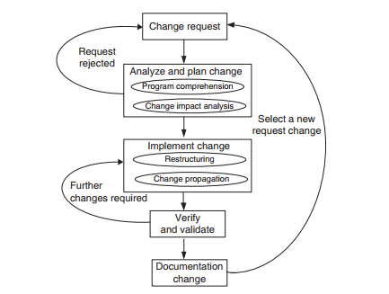
SOFTWARE EVOLUTION MODELS AND PROCESSES
Change Mini-cycle Model
Software change is a fundamental ingredient of software evolution and maintenance.
Let us revisit the first law of software evolution which is stated as:
“A program undergoes continuing changes or becomes less useful. The change process continues until it becomes cost-effective to replace the program with a re-created version.”
The change min-cycle
Fig: The change min-cycle

Slide 27
SOFTWARE EVOLUTION MODELS AND PROCESSES
Change Mini-cycle Model …
The change mini-cycle model consists of five major phases: CR, analyze and plan change, implement change, verify and validate, and documentation change.
Change request: A CR generally originates from the management, users of the software, or customers. A CR may take one of the following two forms: defect report and enhancement request.
Analyze and plan change: In the second phase, program comprehension and impact analysis are conducted.
Program comprehension is essential to understanding which parts of the software will be affected by a CR.
Program comprehension is basically a process of acquiring useful information from source code.
Impact analysis is conducted to identify the potential consequences of a change and estimate the resources needed to accomplish the change

Slide 28
SOFTWARE EVOLUTION MODELS AND PROCESSES
Change Mini-cycle Model …
Implement change: The CR is implemented after the feasibility of a change is established.
before the implementation of the CR, restructuring or refactoring of the software is performed in order to accommodate the requested modification.
Verify and validate: In this phase the software system is verified and validated in order to assure that the integrity of the system has not been compromised.
This activity includes code review, regression testing, and execution of new tests if necessary.
Regression testing comprises a subset of the unit-, integration-, and system-level tests
Documentation change: The final phase of the change mini-cycle deals with updating the program documentation.
It is time to complete the documentation aspect which may include updating the requirements, functional specifications, and design specifications to be consistent with the code.

Slide 29
Software Maintenance Standards
Software Maintenance Standards: A well-defined process for software maintenance can be observed and measured, and thus improved.
IEEE and ISO have both addressed s/w maintenance processes.
IEEE/EIA 1219 and ISO/IEC 14764 as a part of ISO/IEC12207 (life cycle process).
IEEE/EIA 1219 organizes the maintenance process in seven phases:
Problem identification, Analysis, Design, Implementation, System test, Acceptance test and Delivery.
for each phase, the standard identifies the input and output deliverables, the supporting processes and the related activities, and a set of evaluation metrics.

Slide 30
Software Configuration Management
Software Configuration Management: Configuration management (CM) is the discipline of managing and controlling changes in the evolution of software systems.
The goal of CM is to manage and control the various extensions, adaptations, and corrections that are applied to a system over its lifetime.
An SCM system has four different elements, each element addressing a distinct user need as follows:
Identification of software configurations: This includes the definitions of the different artifacts, their baselines or milestones, and the changes to the artifacts.
Control of software configurations: controlling the ways artifacts or configurations are altered with the necessary technical and administrative support.
Auditing software configurations: Making the current status of the software system in its life cycle visible to management and determining whether or not the baselines meet their requirements.
Accounting software configuration status: providing an administrative history of how the software system has been altered, by recording the activities

Slide 31
Reengineering
Reengineering implies a single cycle of taking an existing system and generating from it a new system, Whereas evolution can go forever.
To a large extent, software evolution can be seen as repeated software reengineering.
Reengineering includes some kind of reverse engineering activities to design an abstract view of a given system.
The new abstract view is restructured, and forward engineering activities are performed to implement the system in its new form.
The aforementioned process is captured by Jacobson and Lindst¨orm with the following expression:
Reengineering = Reverse engineering + Δ + Forward engineering.

Slide 32
Reengineering…
The first element “reverse engineering” is the activity of defining a more abstract and easier to understand representation of the system.
For example, the input to the reverse engineering process is the source code of the system, and the output is the system architecture.
The core of reverse engineering is the process of examination of the system, and it is not a process of change.
The third element “forward engineering” is the traditional process of moving from a high-level abstraction and logical, implementation-independent design to the physical implementation of the system.
The second element “Δ” captures alterations performed to the original system.

Slide 33
Legacy Systems
A legacy software system is an old program that continues to be used because it still meets the users’ needs, in spite of the availability of newer technology or more efficient methods of performing the task.
It is the phase out stage of the software evolution model of Rajlich and Bennet described earlier.
There are a number of options available to manage legacy systems. Typical solution include:
Freeze: The organization decides no further work on the legacy system should be performed.
Outsource: An organization may decide that supporting software is not core business, and may outsource it to a specialist organization offering this service.

Slide 34
Legacy Systems…
Carry on maintenance: Despite all the problems of support, the organization decides to carry on maintenance for another period.
Discard and redevelop: Throw all the software away and redevelop the application once again from scratch.
Wrap: It is a black-box modernization technique – surrounds the legacy system with a software layer that hides the unwanted complexity of the existing data, individual programs, application systems, and interfaces with the new interfaces.
Migrate: Legacy system migration basically moves an existing, operational system to a new platform, retaining the legacy system’s functionality and causing minimal disruption to the existing operational business environment as possible.

Slide 35
Impact Analysis
Impact analysis is the task of estimating the parts of the software that can be affected if a proposed change request is made.
Impact analysis techniques can be partitioned into two classes:
Traceability analysis In this approach the high-level artifacts such as requirements, design, code and test cases related to the feature to be changed are identified.
A model of inter-artifacts such that each artifact in one level links to other artifacts is constructed, which helps to locate a pieces of design, code and test cases that need to be maintained.
Dependency (or source-code) analysis Dependency analysis attempt to assess the affects of change on semantic dependencies between program entities.
This is achieved by identifying the syntactic dependencies that may signal the presence of such semantic dependencies.
The two dependency-based impact analysis techniques are: call graph based analysis and dependency graph based analysis.

Slide 36
Refactoring
Refactoring is the process of making a change to the internal structure of software to make it easier to understand and cheaper to modify without changing its observable behavior.
It is the object-oriented equivalent of restructuring.
Refactoring, which aims to improve the internal structure of the code, achieve through the removal of duplicate code, simplification, making code easier to understand, help to find defects and adding flexibility to program faster.
There are two aspects of the above definition:
It must preserve the “observable behavior” of the software system (through regression).
To improve the internal structure of a software system (improve maintainability).

Slide 37
Software Reuse
Software reuse was introduced by Dough McIlroy in his 1968 seminal paper:
The development of an industry of reusable source-code software components and the industrialization of the production of application software from off-the-shelf components.
Software reuse is using existing artifacts or software knowledge during the construction of a new software system.
Reusable assets can be either reusable artifacts or software knowledge.
Capers Jones identified four types of reusable artifacts:
data reuse, involving a standardization of data formats, Reusable functions imply a standard data interchange format.
architectural reuse, which consists of standardizing a set of design and programming conventions dealing with the logical organization of software,
design reuse, for some common business applications, and
program reuse, which deals with reusing executable code.

Slide 38
Software Reuse
Benefits of Reuse
Increased reliability
Reduced process risk
Increase productivity
Standards compliance
Accelerated development
Improve maintainability
Reduction in maintenance time and effort

Slide 39
References
Alain April, Alain Abran (2008), Software Maintenance Management Evaluation and Continuous Improvement.
Priyadarshi Tripathy, Kshirasagar, 2015, Naik, Software evolution and maintenance : a practitioner’s approach.
Penny Grub, Armstrong A Takang, Software Maintenance Concepts and Practice, 2nd edition

